Slide 1

The Shodan Challenge
Dave Ward’s top ten ways to get two stones stronger
(or your money back!)
Notes:
A pot of gold at the end of the rainbow which we all keep striving towards, it is the journey, not the arriving that counts (and at least you didn’t lose any money!)

Slide 2

These didn’t make it into the top ten
Learn a New Joseki – (Ian Davis)
Notes:
Coming up in my estimation – but don’t try to remember moves by rote, much better to try to understand the moves. I made an interesting observation after a teaching session for Dan players a few years ago. I placed the completed variations on the table and asked whether the positions were good for Black, even or good for White. The result was less than perfect !

Slide 3

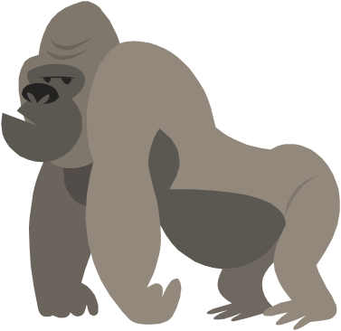
These didn’t make it into the top ten
–Play the board, not the player
.
Notes:
Don’t concern yourself about other peoples grades – The number of times I have heard “I am a four kyu playing a two kyu therefore I have no chance” – play the board not the player. Likewise always respect your opponent, they may be two stones weaker than you in club games, but not today and keep trying, you never know one day you might beat Matthew M (pictured on the right)!

Slide 4
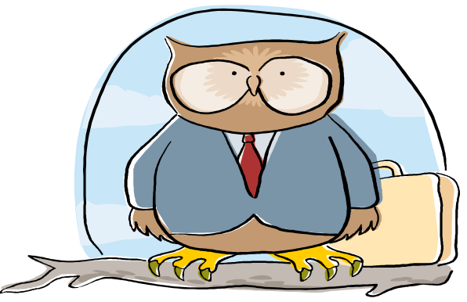
These didn’t make it into the top ten
Ask a stronger player to go through your game afterwards
Notes:
Contrary to what you might think, “stronger players” love to comment on weaker players games. Always take their observations and comments with a pinch of salt – better to cherry pick a recurring general theme rather than get caught up with some complications which your mentor if they are honest probably doesn’t understand any more than you !

Slide 5

These didn’t make it into the top ten
Do more than just play - Discuss games, feed off each other, become enthusiastic; improve together.
Notes:
Working together is a much under utilised teaching resource, possibly one of the greatest single reasons we are under performing as a nation is unlike the French and other nations we don’t work together to try to improve . For some reason most UK Go players spend about one percent of their time in review and 99 % either clearing the stones from the last game or starting a new one. To name a few stronger players that benefited from a group approach, Matthew M, Alex Rix, and myself.

Slide 6


These didn’t make it into the top ten
Look for moves that have more than one meaning
.
Notes:
Look for moves that do more than one thing. E.g. take territory while attacking. This is a really another way of saying use your stones efficiently, if you use your stones more efficiently than your opponent you will win the game.

Slide 7

These didn’t make it into the top ten
Ideally play those 2 or 3 stones stronger than you
Notes:
It is entertaining for me to look at the current professional games on go4go, but I can’t really understand the meaning behind the moves because I don’t have the necessary tools of reading to make comprehension possible. Yajie my teacher suggests that I take a closer look at “simpler professional games from the 70’s and 80’s, or playing stronger players. . For most people achieving an attainable goal by playing someone a little stronger and a review at the end will be useful.

Slide 8
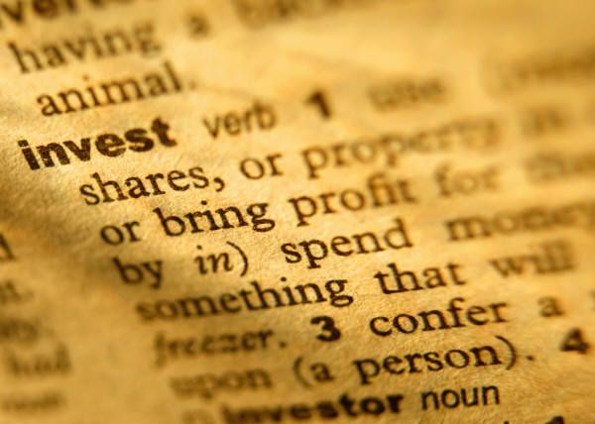
Invest in Loss - Number 10
Be brave, if you lose the game, treat it as an investment for the future.
Notes:
You can learn a lot more from losing a game than from winning. On top of my most embarrassing moments - scored zero out of eight in Amsterdam, played myself into Atari when having a game analysed by professional. You have to Invest in Loss, challenge if you don’t understand, play out semeais against stronger players. If you don’t see how the stones can be caught, you might remember next time !

Slide 9

Compromise in tournaments - Number 9
The clock is a formidable weapon
Notes:
There are basically two kinds of players, the first kind are trying to find truth or understanding on the go board, the second are trying to manage the position. Two opposite ends of the spectrum , Nick Kremple, Alex Selby at one end, T Mark, Phil Beck at the other. The shorter the time limits the more you must compromise. The clock is a formidable weapon, which shouldn’t be underestimated – try to break the game up into three parts ten minutes forty minutes 10 minutes. Beware if you are trying to find “truth” in the position the game always lasts longer than you think !

Slide 10

Any plan - Number 8
“A bad plan is much better than no plan at all”.
Matthew M
.
Notes:
What are you trying to do ?– it is easy to lose focus and find you have wandered off from your basic plan – “O I thought I remembered something like this in a joseki book!” is much used muttered over a pint in the bar afterwards

Slide 11

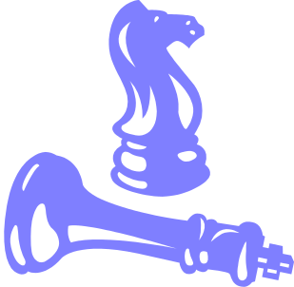
Avoid making a King on the Go Board - Number 7
(Otherwise known as a large eyeless Dragon)
.
Notes:
What do I mean, Go is not chess, but if you create a large weak group then you effectively have a huge liability,(a king). If you played chess with only your opponent having a king you would be in a mighty good position. In China it is often known as a large eyeless Dragon, something to be feared. How many points is it worth to have a large eyeless dragon I estimate anything from minus ten to minus fifty.

Slide 12


Record your games –
Number 6
.
BUT only after the event !
Notes:
Try to get into the habit of recording your games after the event, rather than during the game. I have never yet met a strong player who couldn’t go through the game from memory, and never met a weak player who could. Why is this ? because when you get to a certain level the moves are part of the whole board vision, working together. When Shutai won the Paris tournament he played through all his games on the way back on eurostar, down to the small yose.It really is not so difficult and is a check as to why you play a particular move.

Slide 13

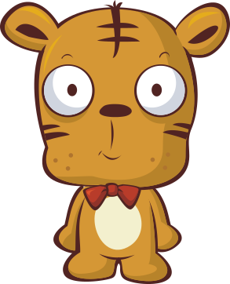

Playing on KGS - Number 5
.
Young Tigers of British Go
Notes:
Playing on KGS or some other server. I myself don’t but I can see the young tigers of tomorrow all do, Will Brooks, Sam Aitken, and a raft of improving BGA one and two dan players. Maybe this is the collaboration forum for would be improvers !?

Slide 14

Take professional lessons –Number 4
Not so expensive and give good clear advise.
.
Notes:
Always useful to have a second opinion, particularly if you have lost and your opponent insists on telling you where you went wrong. Nice to drop a line in the journal at a later date where the commentary is of a higher level and where your tormentors “you must play there” no longer appears ! I would like to say that lessons lead to guaranteed improvement but it sometimes feels like the same old mistakes in a different form; if something good rubs off take it as a bonus.

Slide 15

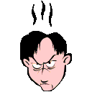

Take your time after a bad move
- Number 3
Otherwise it will surely be followed by a worse one !
.
Notes:
Controlling your emotions is a necessary skill. It is so tempting to get flustered and rush to make up the loss you have suffered. The fact is that you will most likely get some chance later in the game unless the mistake is too big. One way of improving at Go is to try to make your bad moves better, this is true in all games – often the winner didn’t do anything very clever – I often feel that this is particularly true of the stronger Japanese players who visit the club, they are not trying to make something happen but content to sit back and play calmly.

Slide 16


Study Life and Death - Number 2
.
8 hours a day for six years
Notes:
Study life and death problems is the reality of getting stronger, don’t let anyone tell you otherwise. I was in Korea a couple of years ago and played the number one amateur player who had been in insei group one for six years. After losing a three stone game I asked what was needed for me to improve HE SAID “DID I LIKE GAMBLING GAMES” what did he mean ? well simply that my reading was not accurate. Mr Han had spent 8 hours every day for six years studying life and death – I don’t think he liked gambling games! Nearly all professionals I have met put solving problems as the most important part of getting stronger.

Slide 17

If… you can enjoy the process of learning to play Go –
Number 1
Triumph and disaster treat the two impostors just the same
.
Notes:
Most people would like to get at least a little stronger, but trying to change often seems like one step forward two back. For us amateurs enjoyment is what counts, so lick your wounds after a bad tournament and come back and enjoy the next game.
“If you can fill the unforgiving minute by playing a move before the clock falls, then yours is the earth and everything that’s in it “….sorry Rudyard!

